Slide 1
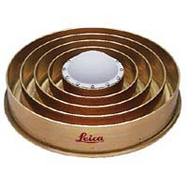
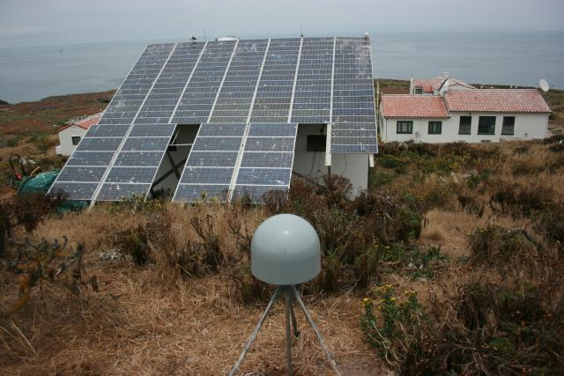
MULTIPATH, day 2
ASEN 5090
ASEN 5090 LECTURE NOTES – LARSON, AXELRAD

Slide 2
Questions about homework 5
What metrics do you want?
2
K. Larson and P. Axelrad, University of Colorado

Slide 3
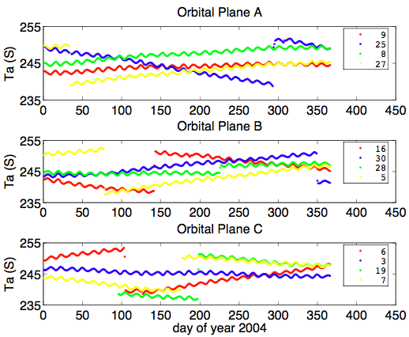
This is the exact answer to the last questions for homework 3.
K. Larson and P. Axelrad, University of Colorado

Slide 4
Outline for Multipath
What causes multipath?
How can you avoid it?
How does multipath affect GPS pseudorange measurements?
SNR data?
Can multipath be useful? (started)

Slide 5
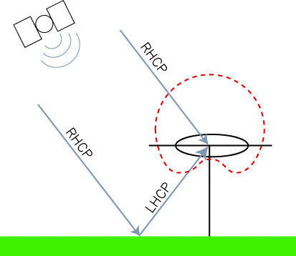
GPS transmits Right Hand Circularly Polarized Signal
Reflection is RHCP + LHCP
5
K. Larson and P. Axelrad, University of Colorado

Slide 6
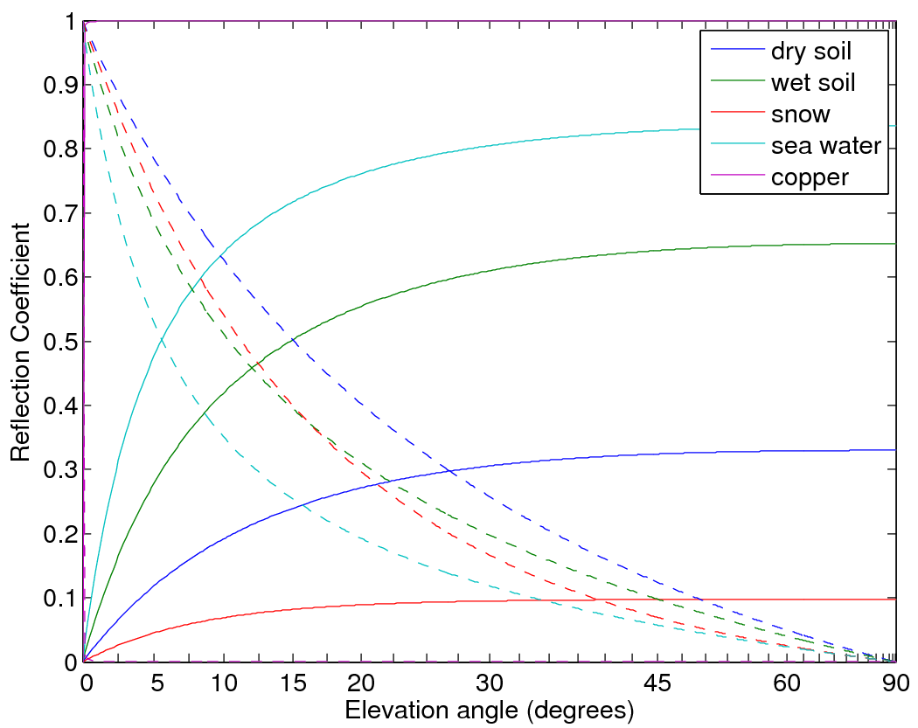
6
K. Larson and P. Axelrad, University of Colorado

Slide 7
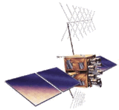
General Problem
GPS
transmitter
Reflector geometry (elevation angle and antenna height) and GPS transmit frequency
The reflector characteristics (dielectric constant, smoothness of the surface)
The gain pattern of the receiving antenna (s).
Number of receivers.
GPS
instrument
Reflection Surface

Slide 8
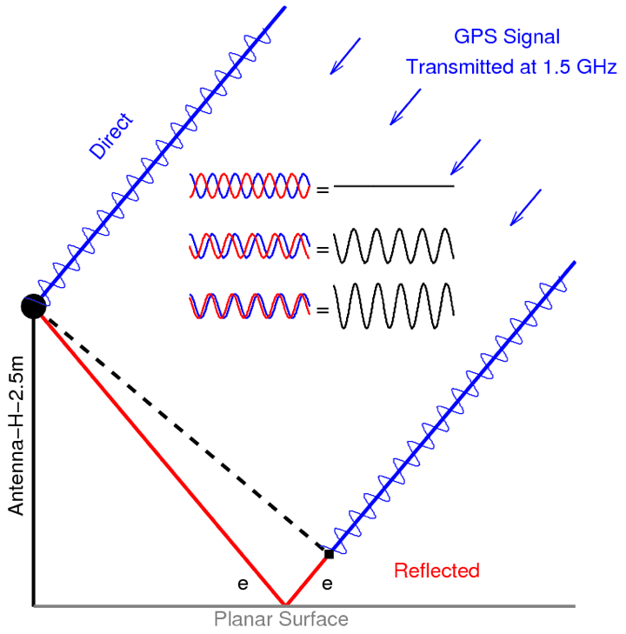

Slide 9
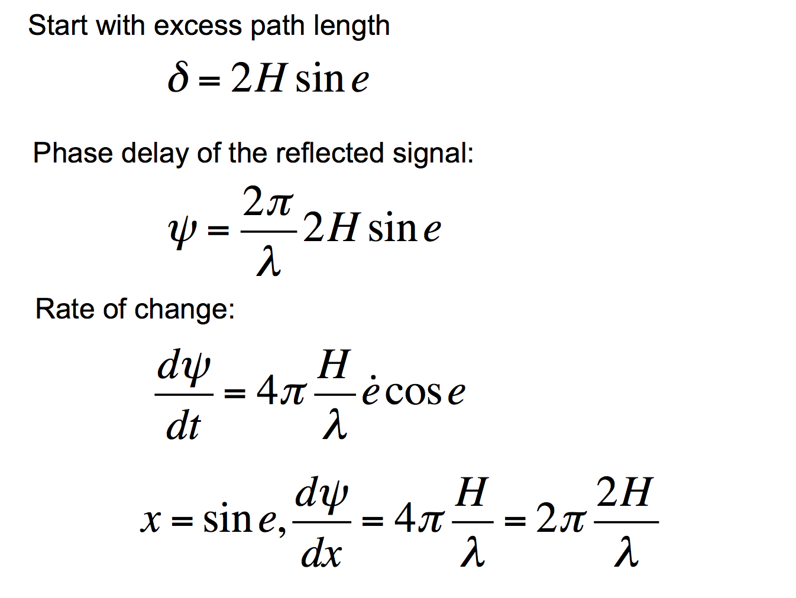
Change of variable

Slide 10
How does that extra path length influence the GPS observables? 1. Pseudorange 2. Signal to Noise Ratio data

Slide 11
What is alpha? Does this expression make sense?
How does multipath affect pseudorange measurements?
M

Slide 12
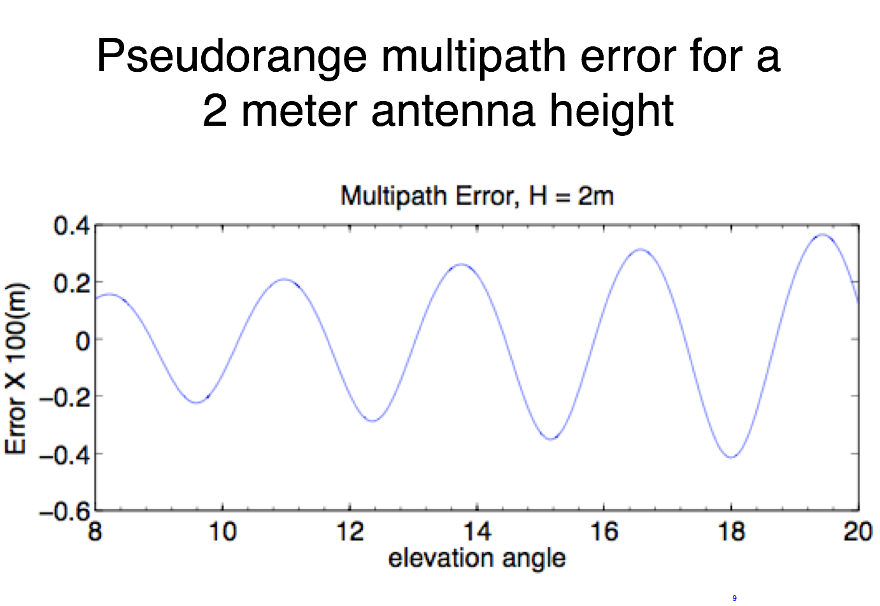

Slide 13
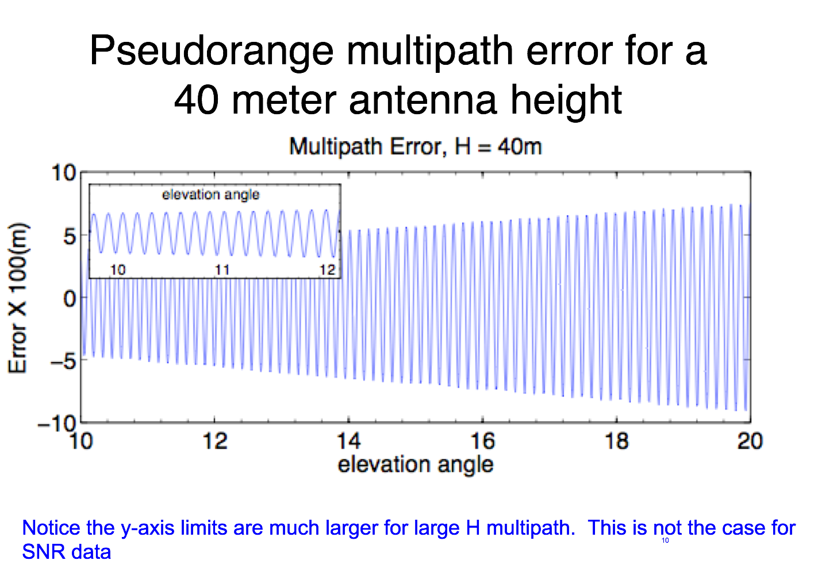

Slide 14
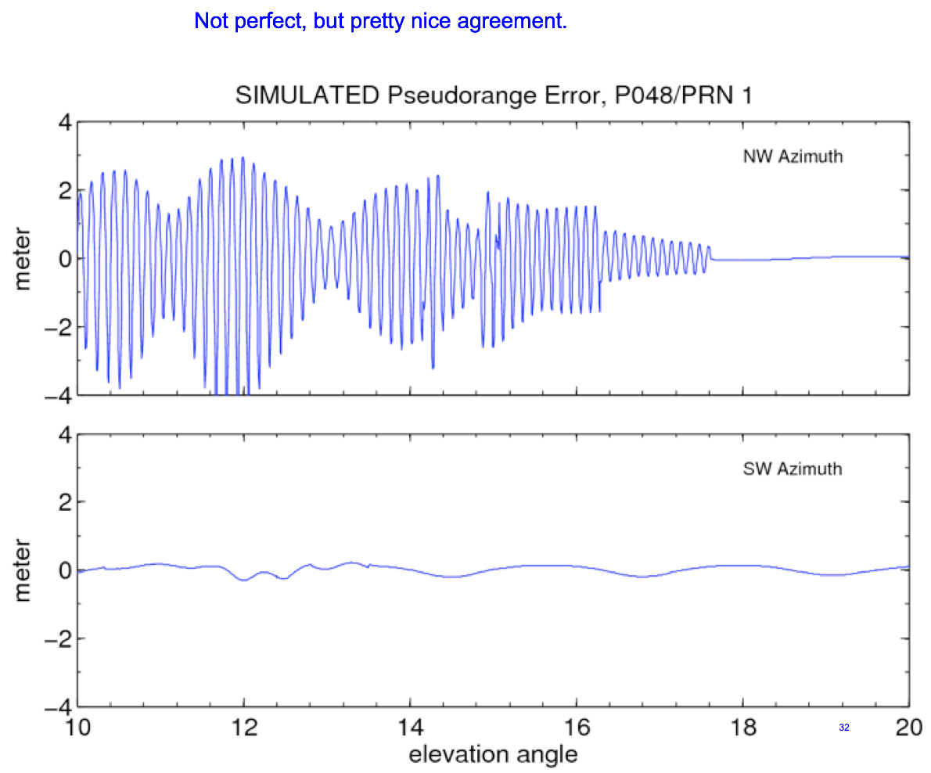
Simulation – taking into account the gain pattern

Slide 15
GPS
transmitter
The simple case we always show
GPS
instrument
Reflection Surface

Slide 16
Real life
close reflector multipath
reflecting surface
16

Slide 17
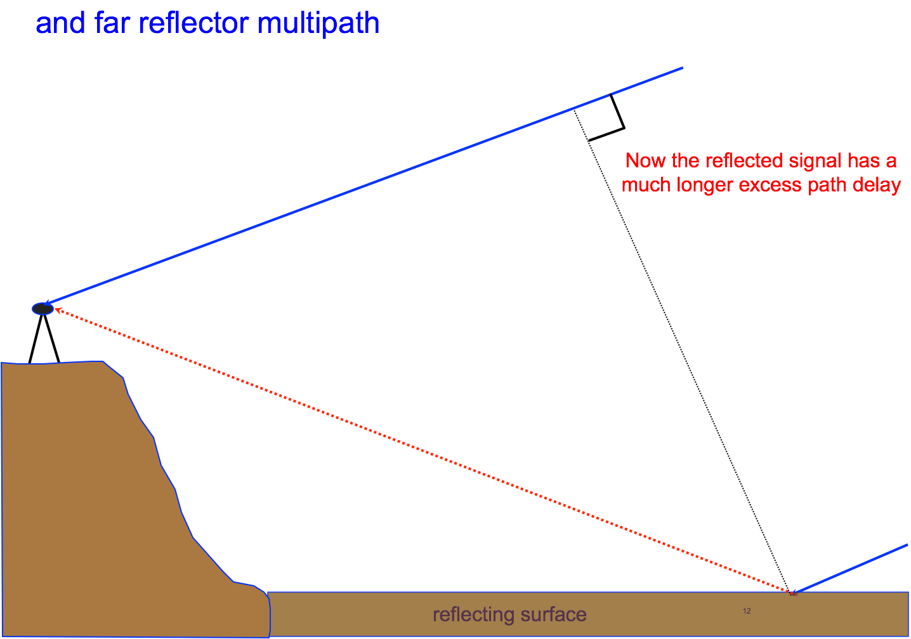

Slide 18
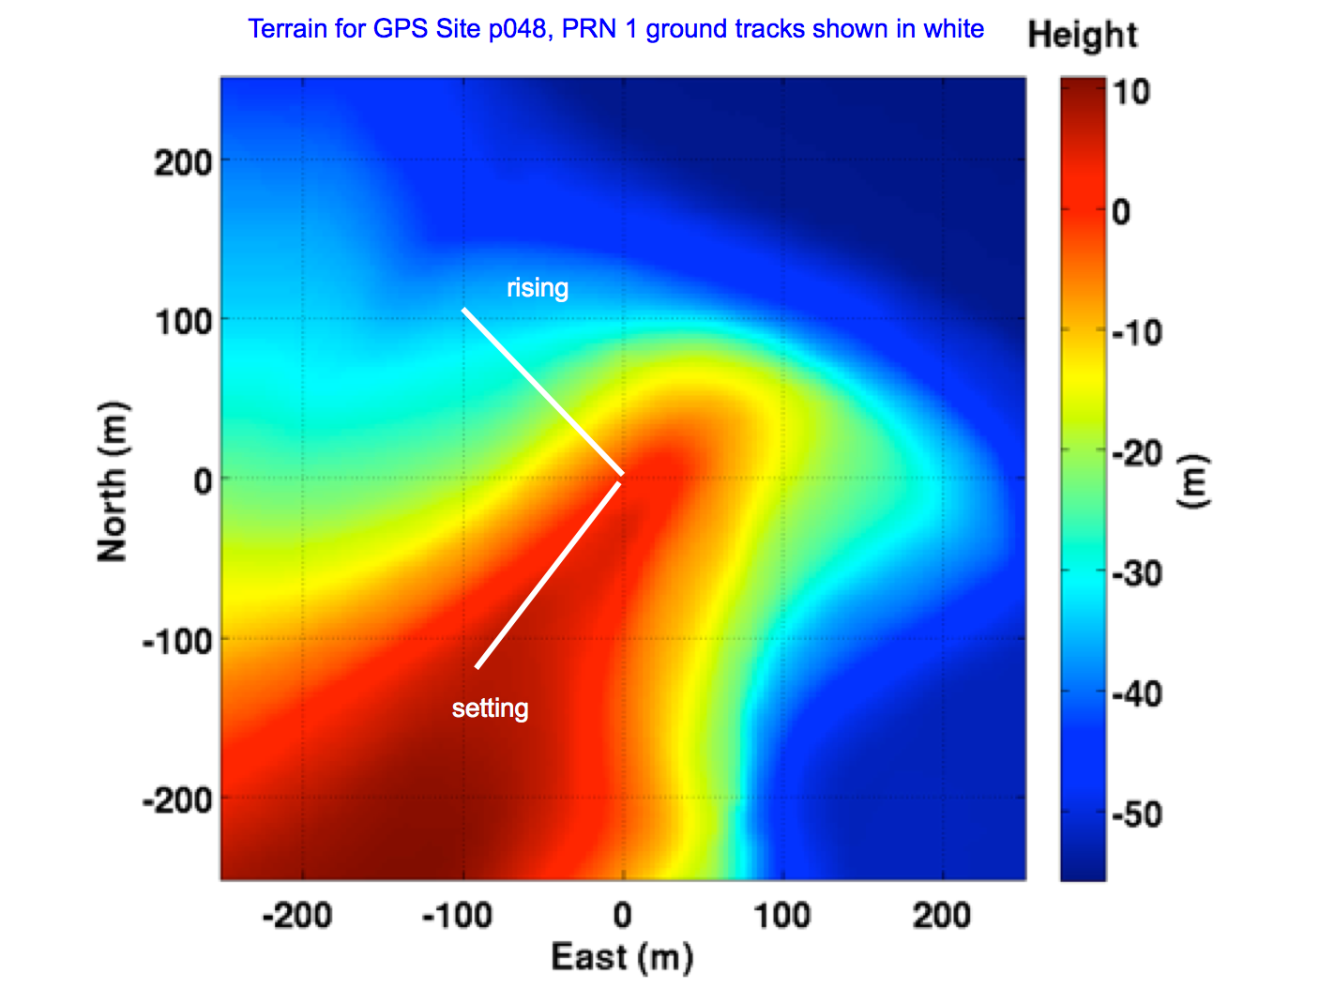

Slide 19
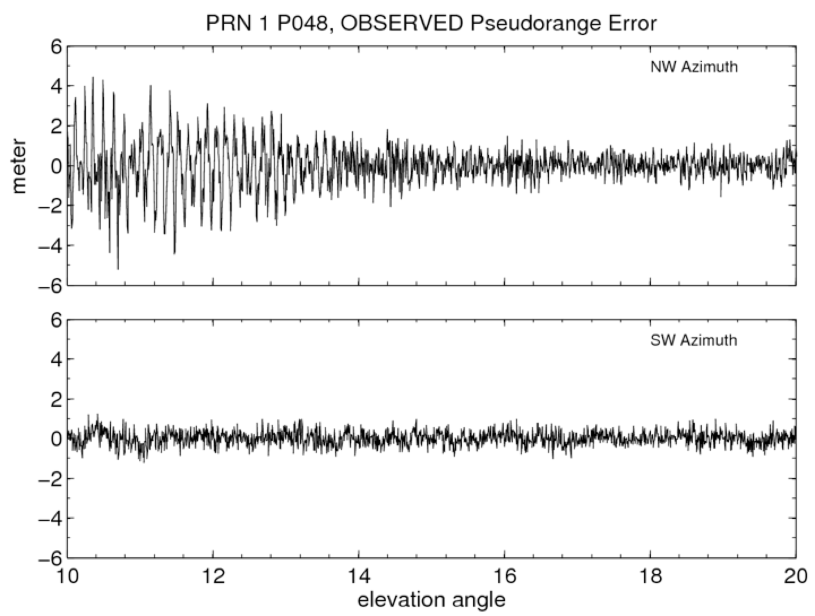

Slide 21
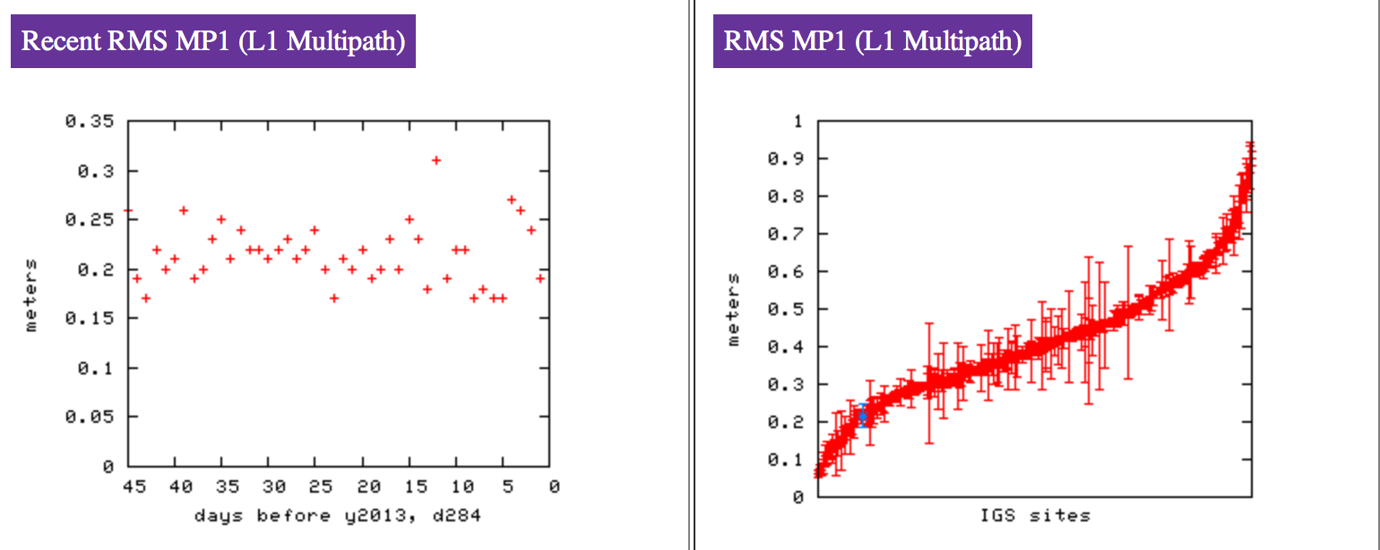
How can we compile a statistic to look at changes in pseudorange?

Slide 22
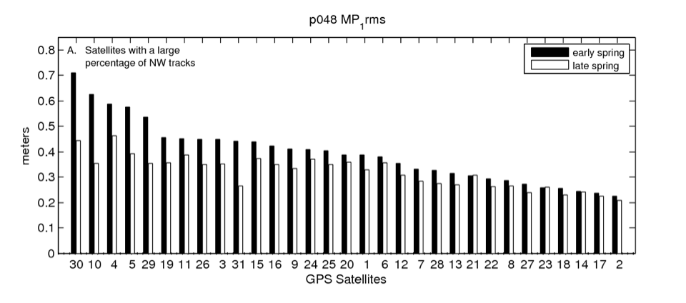
Standard Deviation of L1 Pseudorange Error
Many network operators provide the average of these values each day. Opportunity for easy remote sensing.

Slide 23
Ordinarily could show you some stats, but all government websites have gone kablooey
Many network operators provide the average of these values each day. Opportunity for easy remote sensing.

Slide 24
Many network operators provide the average of these values each day. Opportunity for easy remote sensing.

Slide 25
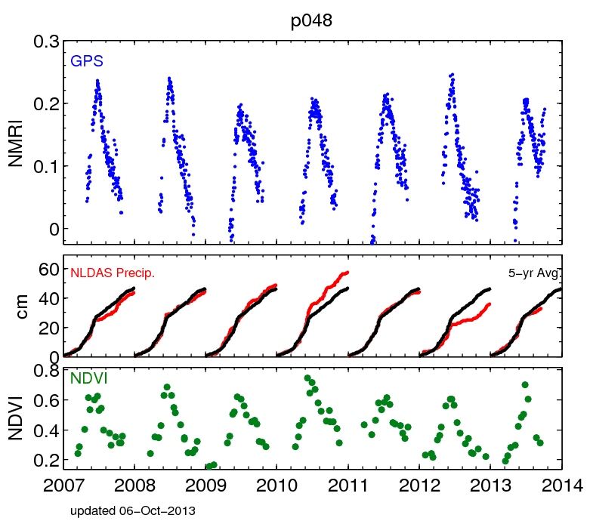
Many network operators provide the average of these values each day. Opportunity for easy remote sensing.

Slide 26
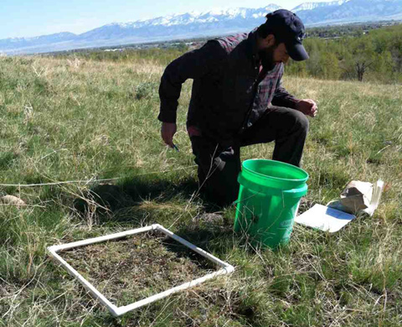
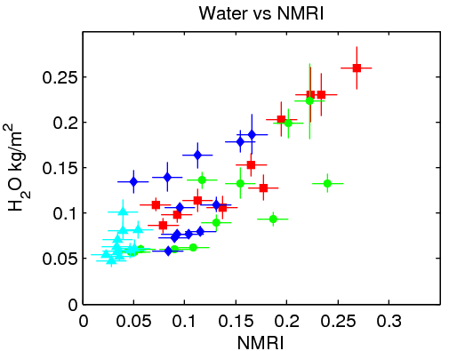
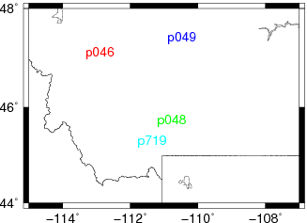
GPS Reflection Ratio
Good agreement with in situ sampling of the vegetation.

Slide 27
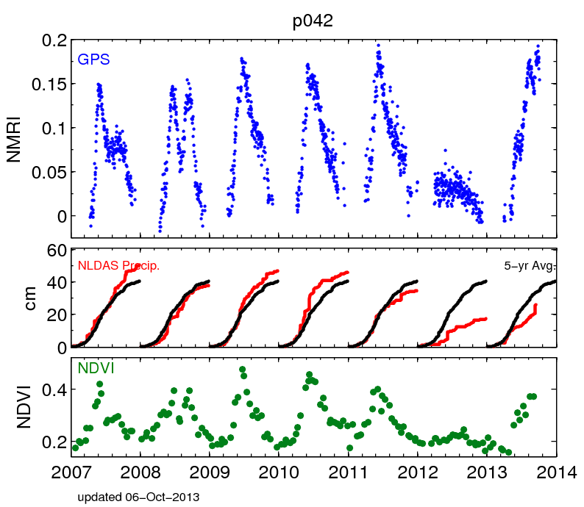
Many network operators provide the average of these values each day. Opportunity for easy remote sensing.

Slide 28
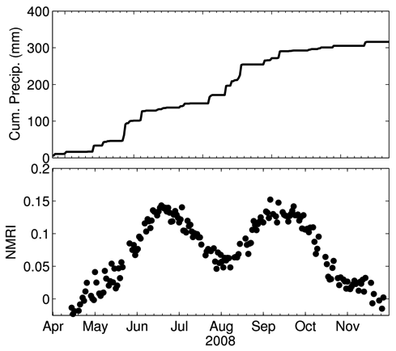
Many network operators provide the average of these values each day. Opportunity for easy remote sensing.

Slide 29
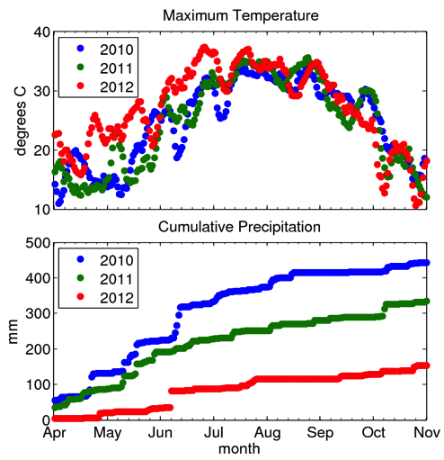
Many network operators provide the average of these values each day. Opportunity for easy remote sensing.

Slide 30
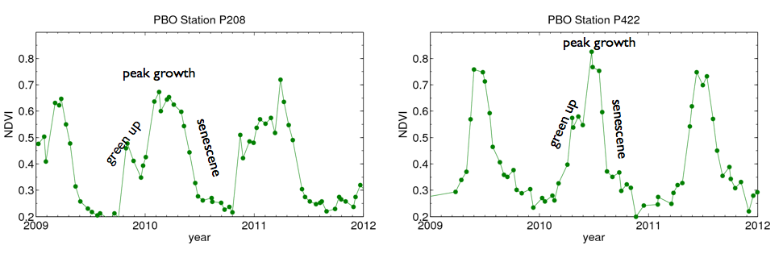
Many network operators provide the average of these values each day. Opportunity for easy remote sensing.

Slide 31
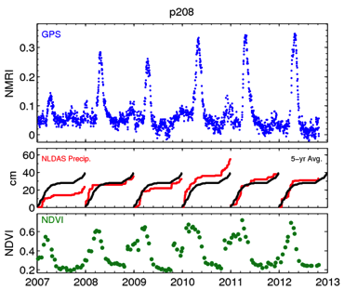
Many network operators provide the average of these values each day. Opportunity for easy remote sensing.

Slide 32
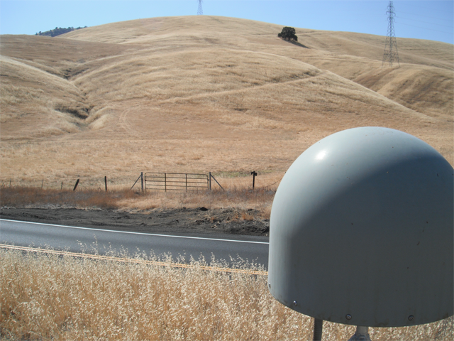
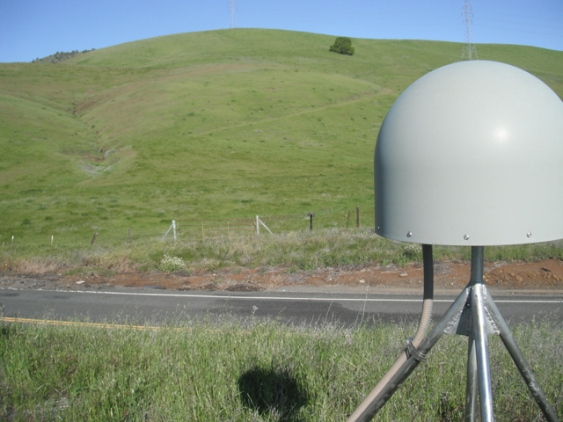
Many network operators provide the average of these values each day. Opportunity for easy remote sensing.

Slide 33
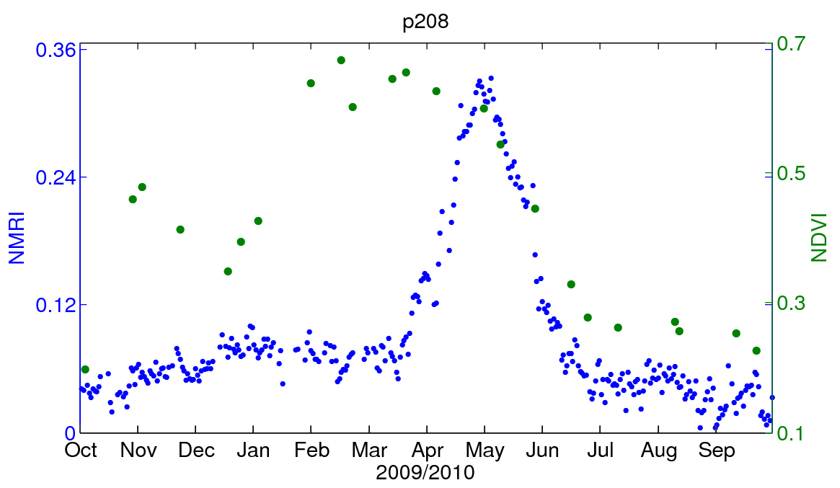
Many network operators provide the average of these values each day. Opportunity for easy remote sensing.

Slide 34
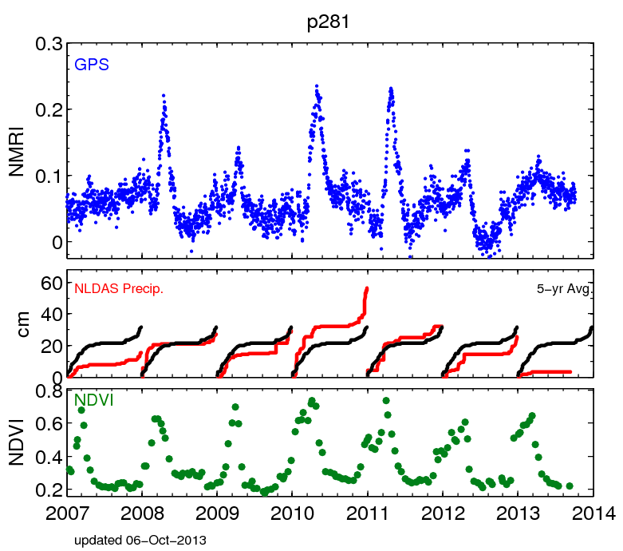
Many network operators provide the average of these values each day. Opportunity for easy remote sensing.

Slide 35
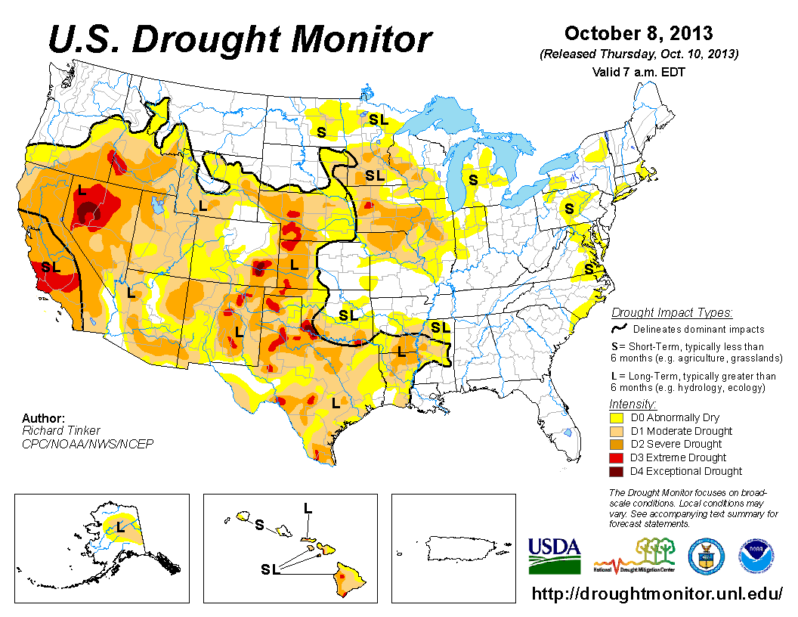
Many network operators provide the average of these values each day. Opportunity for easy remote sensing.

Slide 36
How does that extra path length influence the GPS observables? 1. Pseudorange 2. Signal to Noise Ratio data

Slide 38
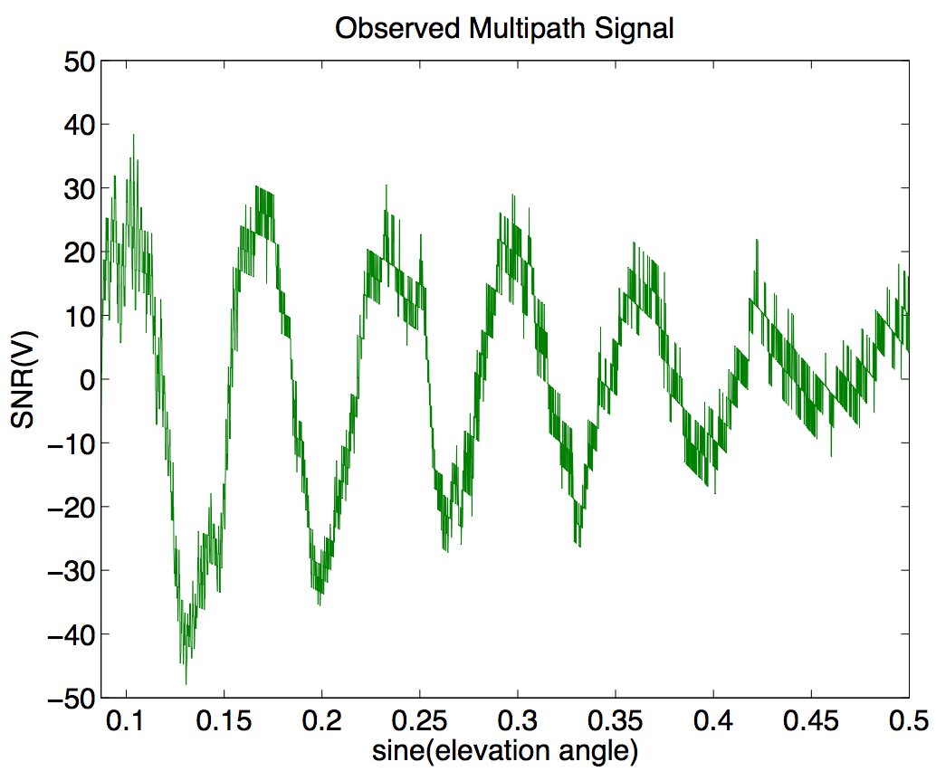
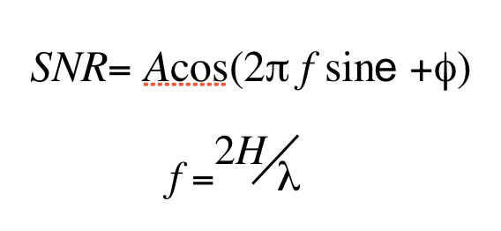
the reflected signal

Slide 39
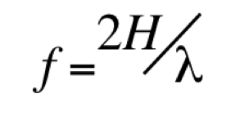
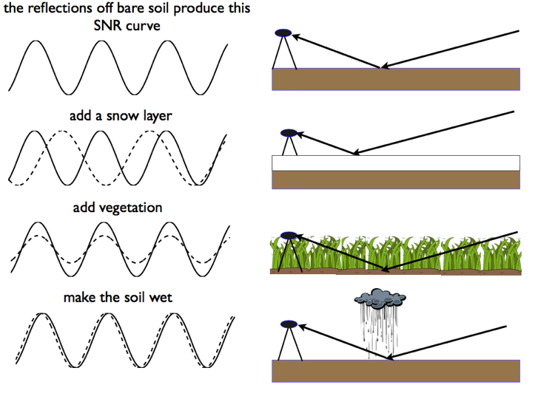

Slide 40
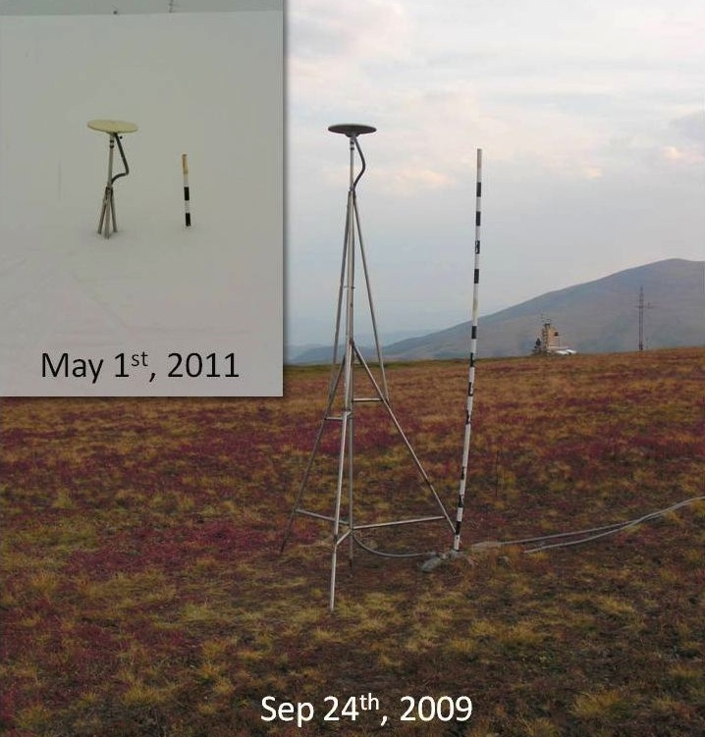

Slide 41
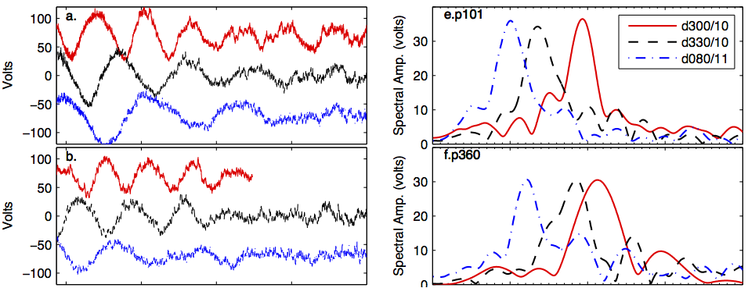
SNR Data
Periodogram

Slide 42
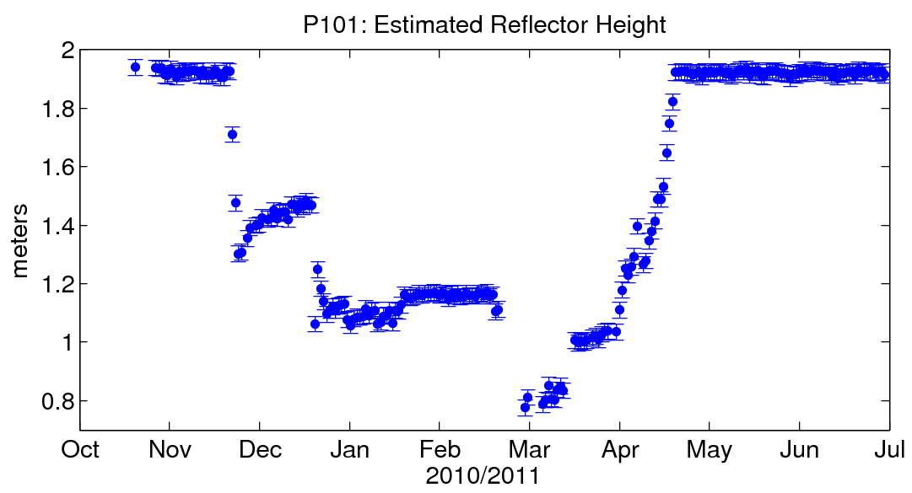

Slide 43
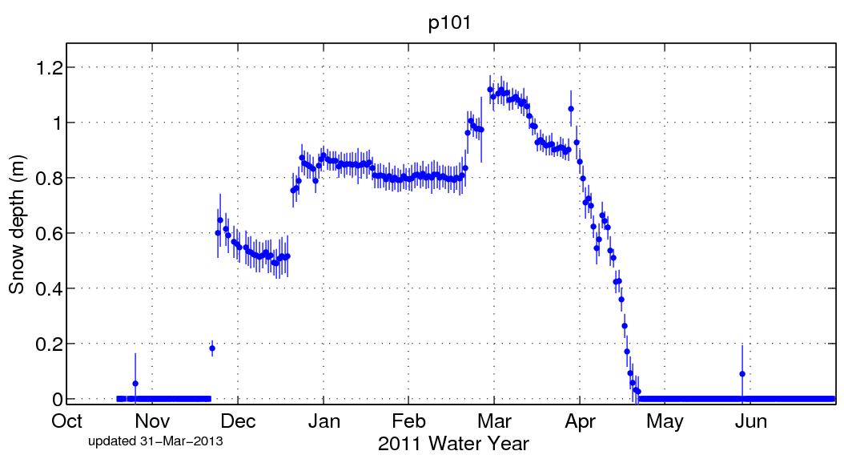

Slide 44
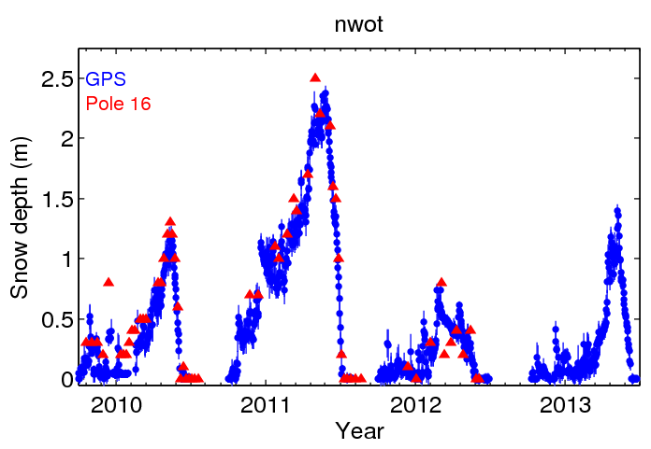

Slide 45
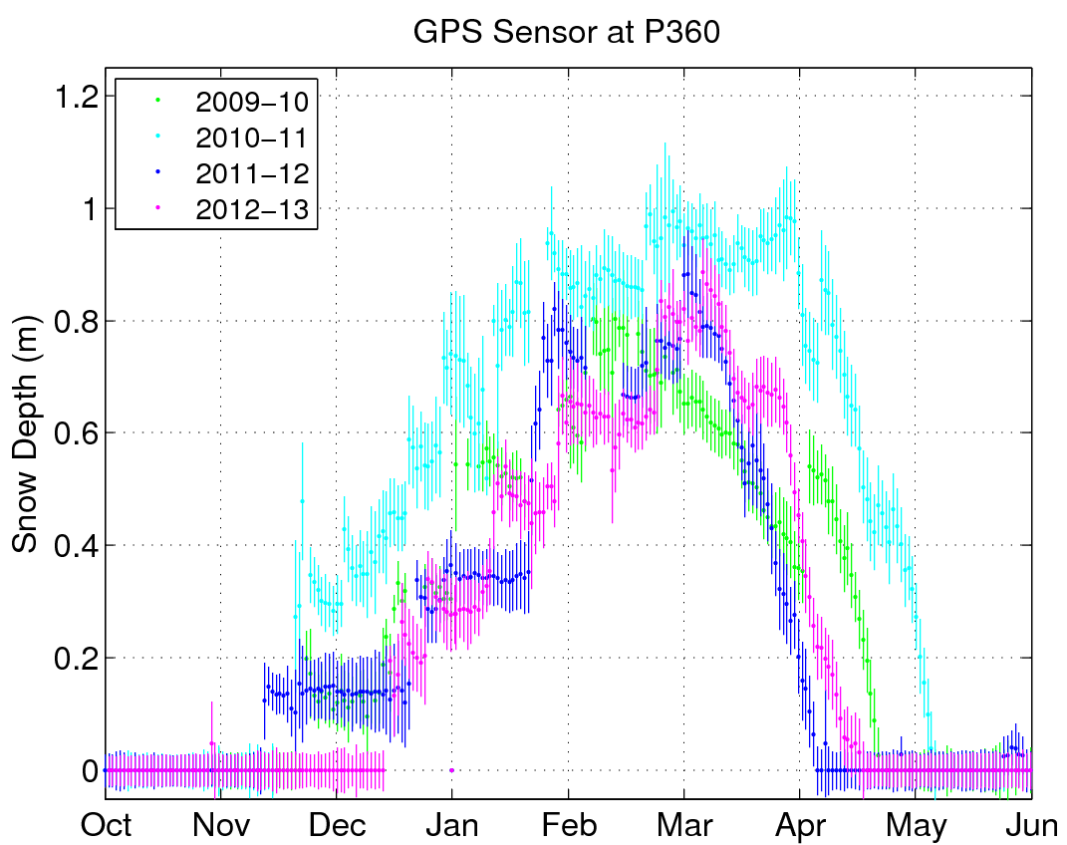

Slide 46
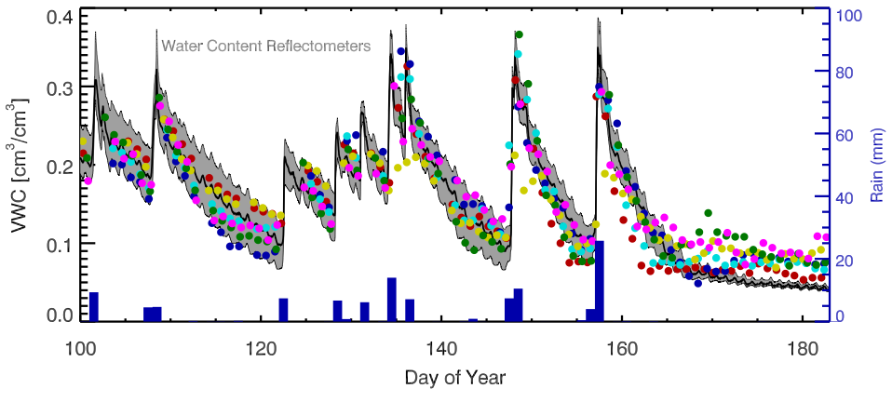
For soil moisture (here in Boulder)
46
K. Larson and P. Axelrad, University of Colorado

Slide 47
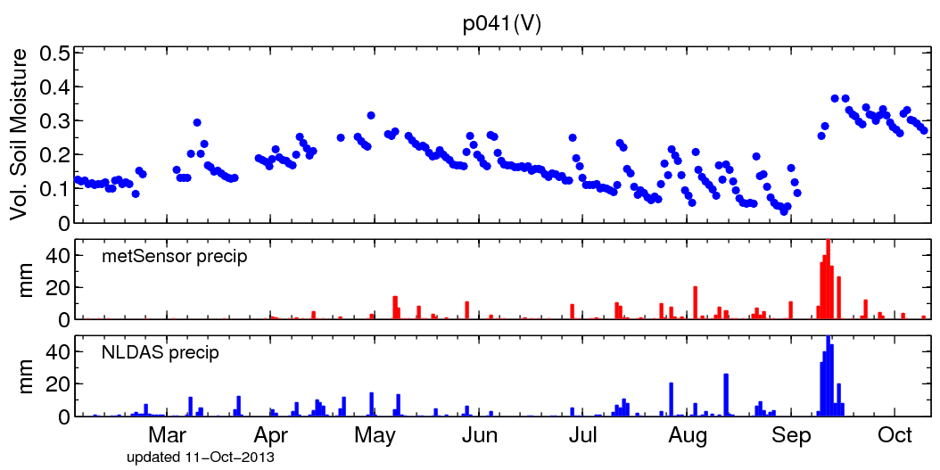

Slide 48
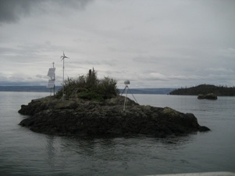
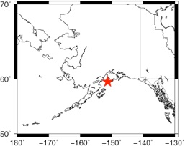
Peterson (Kachemak) Bay, Alaska
GPS site installed to measure crustal deformation
Larson et al., The Accidental Tide Gauge, IEEE GRSL, online.

Slide 49
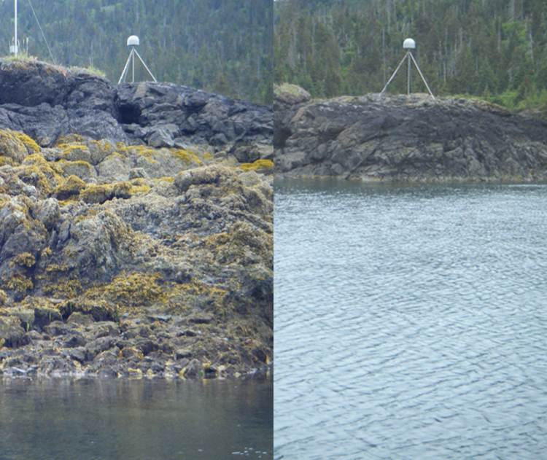
Photo courtesy of Clara Chew
Very big tides-7 meters!

Slide 50
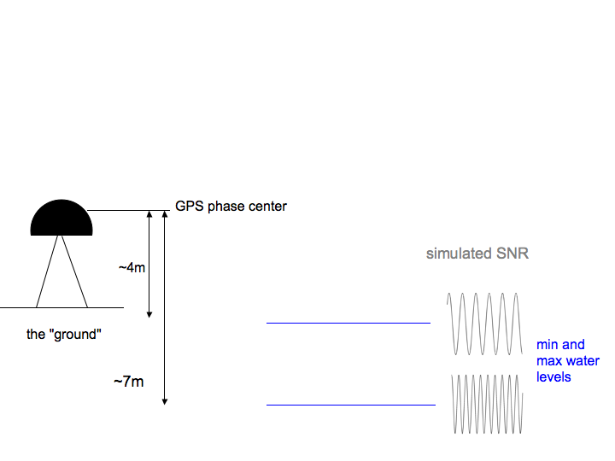
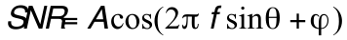
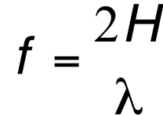
Simple model (assumes horizontal planar reflector)
For SNR (and carrier phase) data
SNR= Acos(2π f sinθ +φ)
e
f =^{2H} λ
H

Slide 51

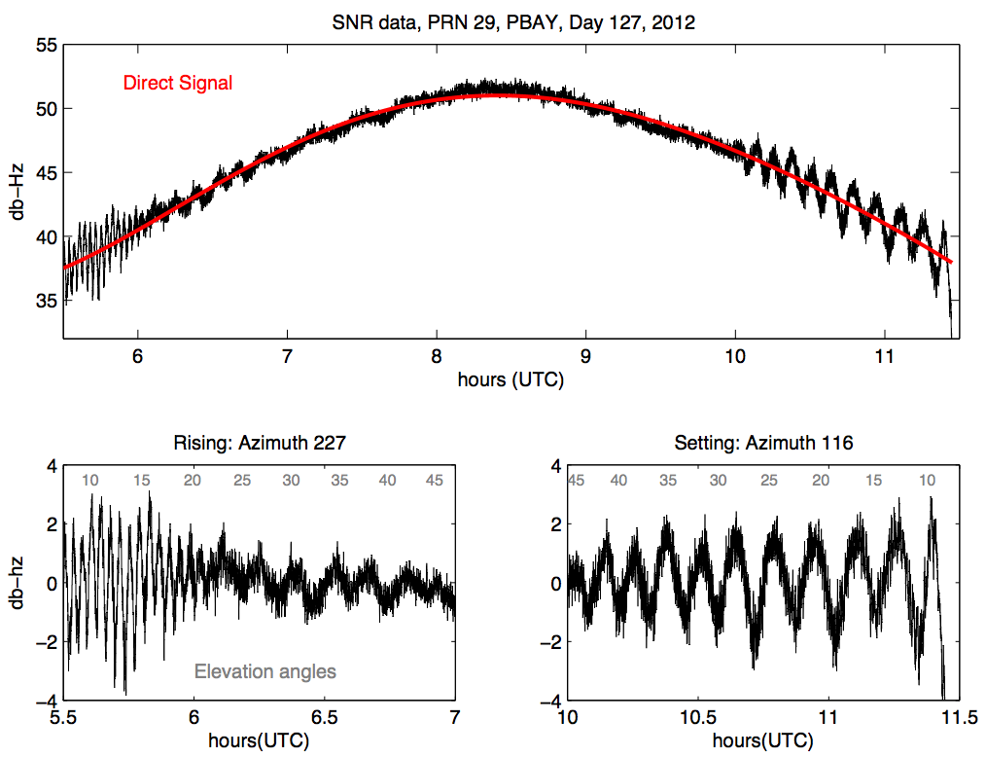
What do the SNR data look like?

Slide 52
52
K. Larson and P. Axelrad, University of Colorado

Slide 53
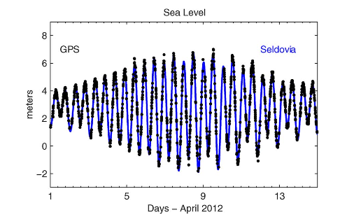

Slide 54
54
K. Larson and P. Axelrad, University of Colorado

